Slide 1
Data Practicum I Suresh Kumar Dontha
TEXAS Accidents Data Analysis and Visualization

Slide 2
Content
Data collection
Exploratory data analysis
Visualizations
Time series Analysis
Linear Regression
K Nearest Neighbor
References

Slide 3

Data Collection
Kaggle – US Accidents Data (3.0 Million Observations)
A Countrywide Traffic Accident Dataset (2016 – 2019)
Extracted the Texas State data from the original dataset (~300K Observation)
51 Variables
60 MB File data.
https://www.kaggle.com/sobhanmoosavi/us-accidents

Slide 4
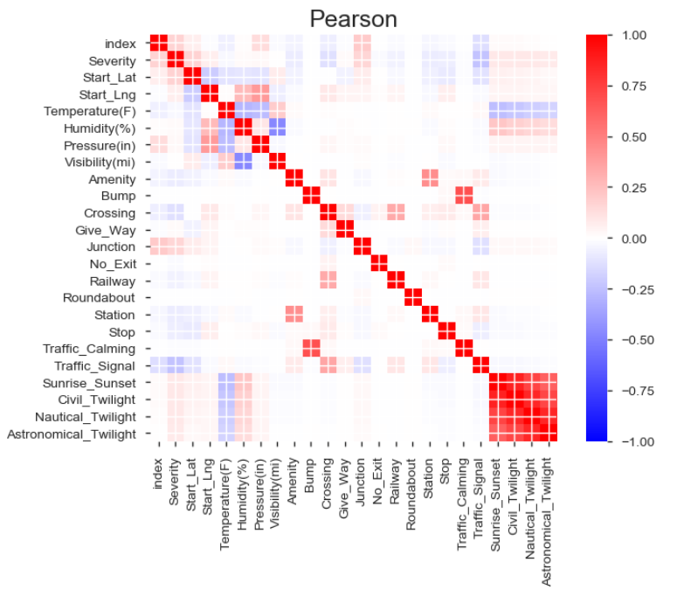

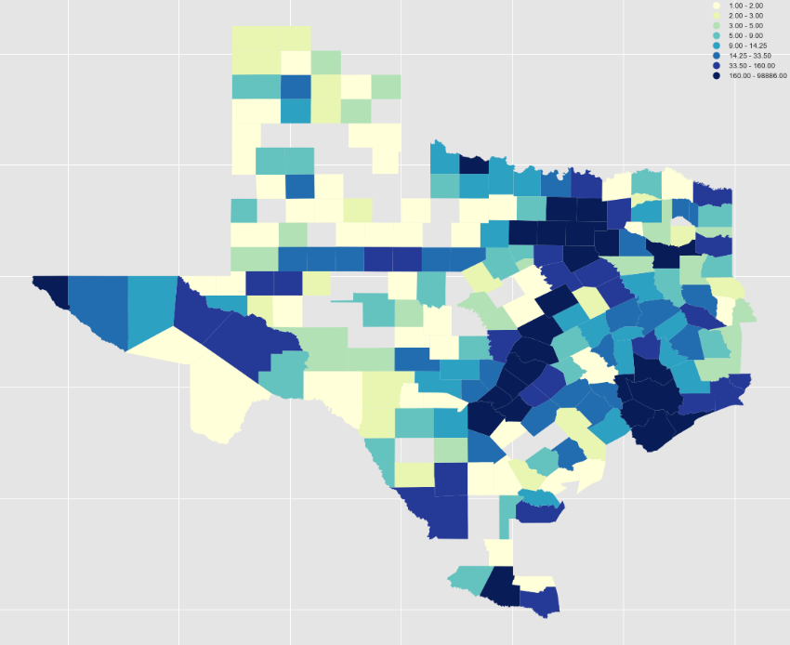

EDA and Choropleth Map of the Accidents Data

Slide 5
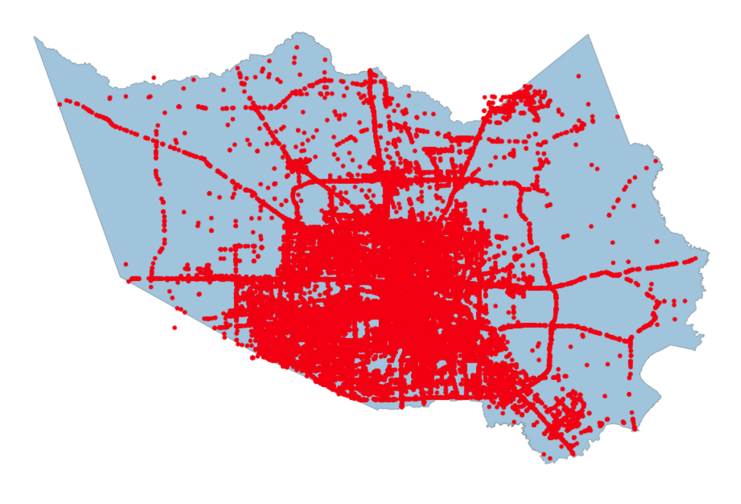

Shapefile and Accident points (geocodes)
Texas state shapefile by county
Texas Accident data has 213 counties data
Any where from 1 to 98886 Accidents
Harris County – 98886 accidents
Dallas County – 68063 accidents
Travis County – 63509 accidents

Slide 6
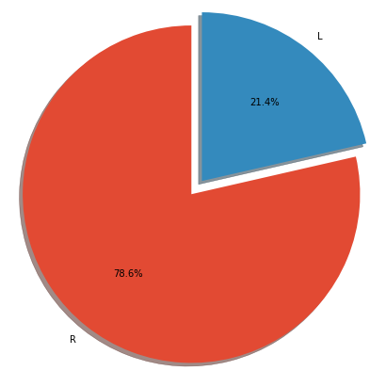
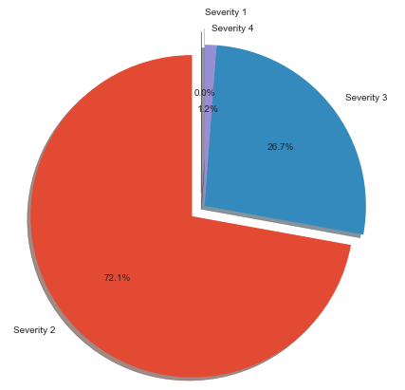
Pie charts
Accident sides L- Left and R-Right side of the road
Accident severity from 1 to 4.
https://machinelearningmastery.com/decompose-time-series-data-trend-seasonality/

Slide 7
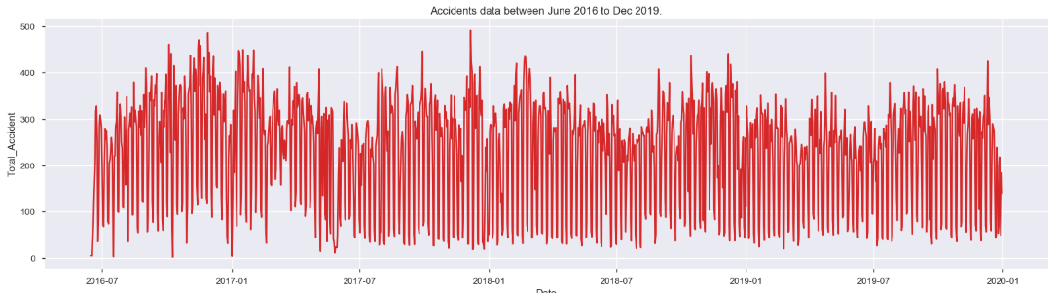
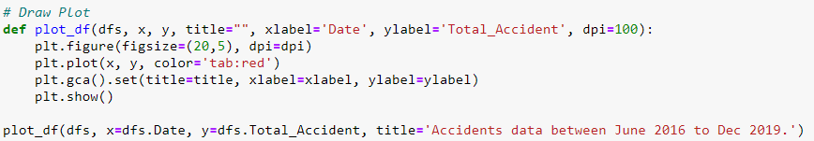
Accidents Data Timeline

Slide 8
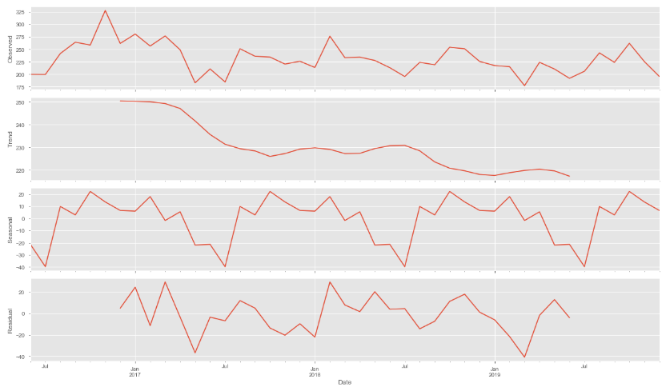
Time Series Decomposition

Slide 9
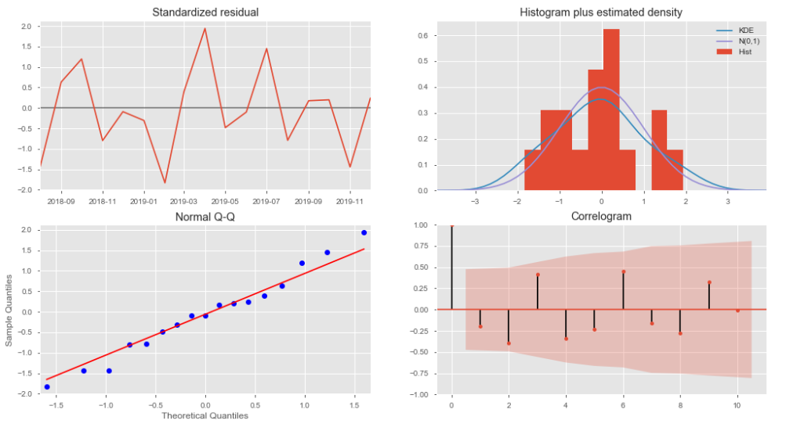
Plot Diagnostics

Slide 10
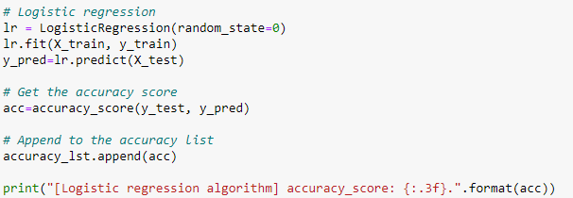
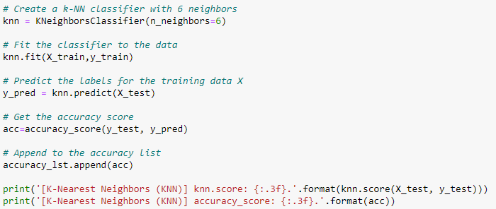

Logistic regression
k-nearest neighbors

Slide 11
References:
• US Accidents (3.0 million records)
https://www.kaggle.com/sobhanmoosavi/us-accidents#US_Accidents_Dec19.csv
• A Countrywide Traffic Accident Dataset∗
https://arxiv.org/pdf/1906.05409.pdf
• Accident Risk Prediction based on Heterogeneous Sparse Data: New Dataset and Insights
https://arxiv.org/pdf/1909.09638.pdf

